Slide 1
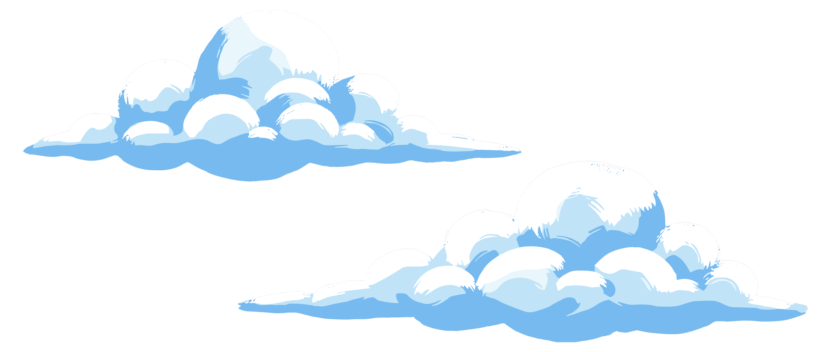
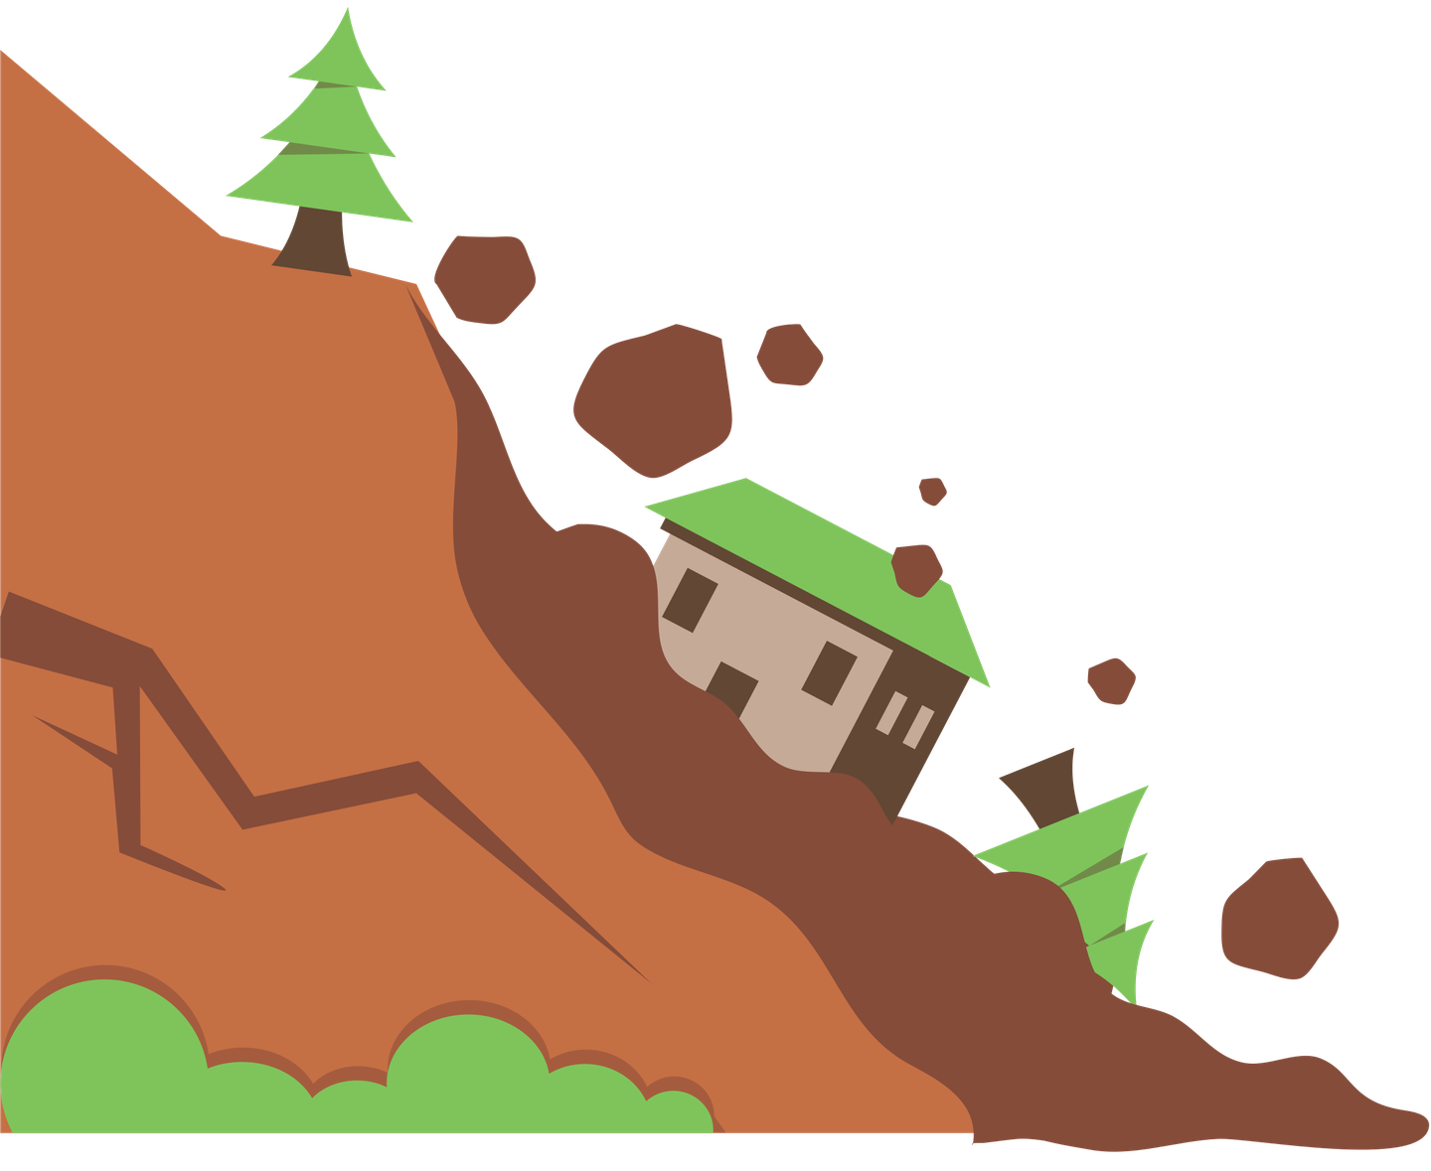
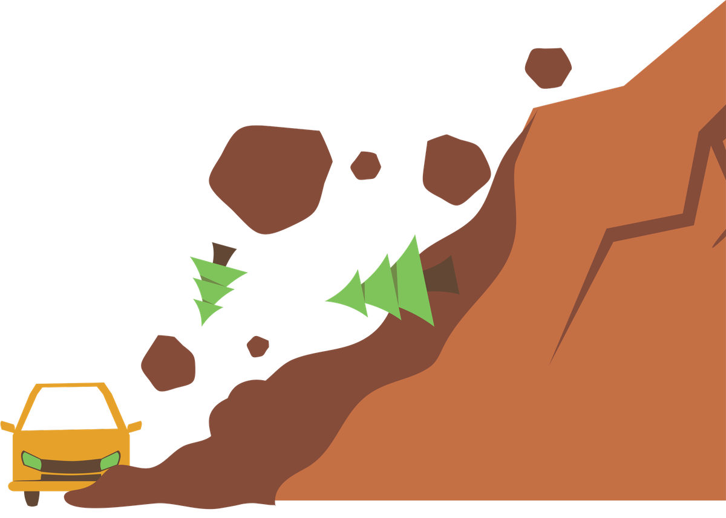
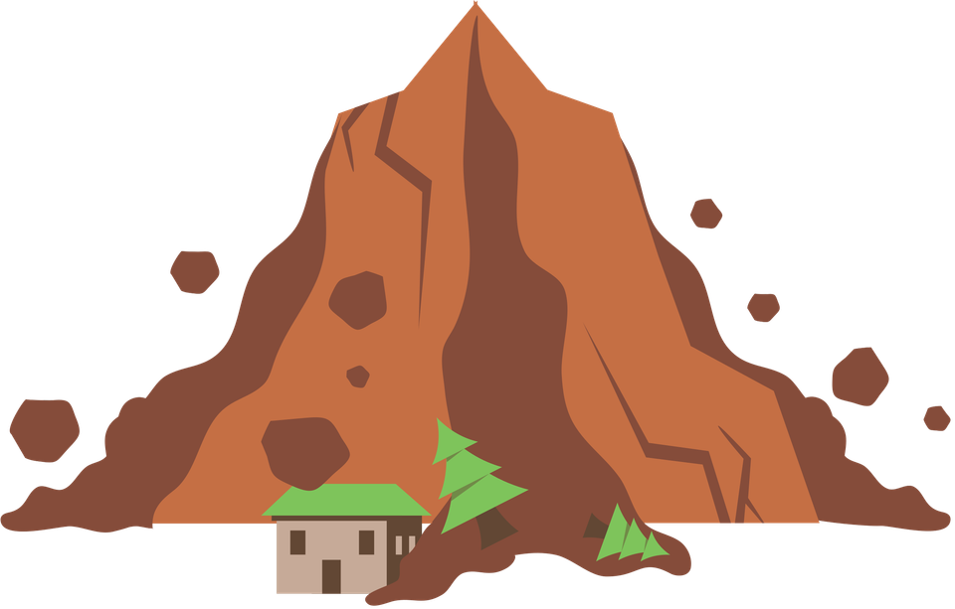
WEATHERING
& EROSION
And Deposition

Slide 2
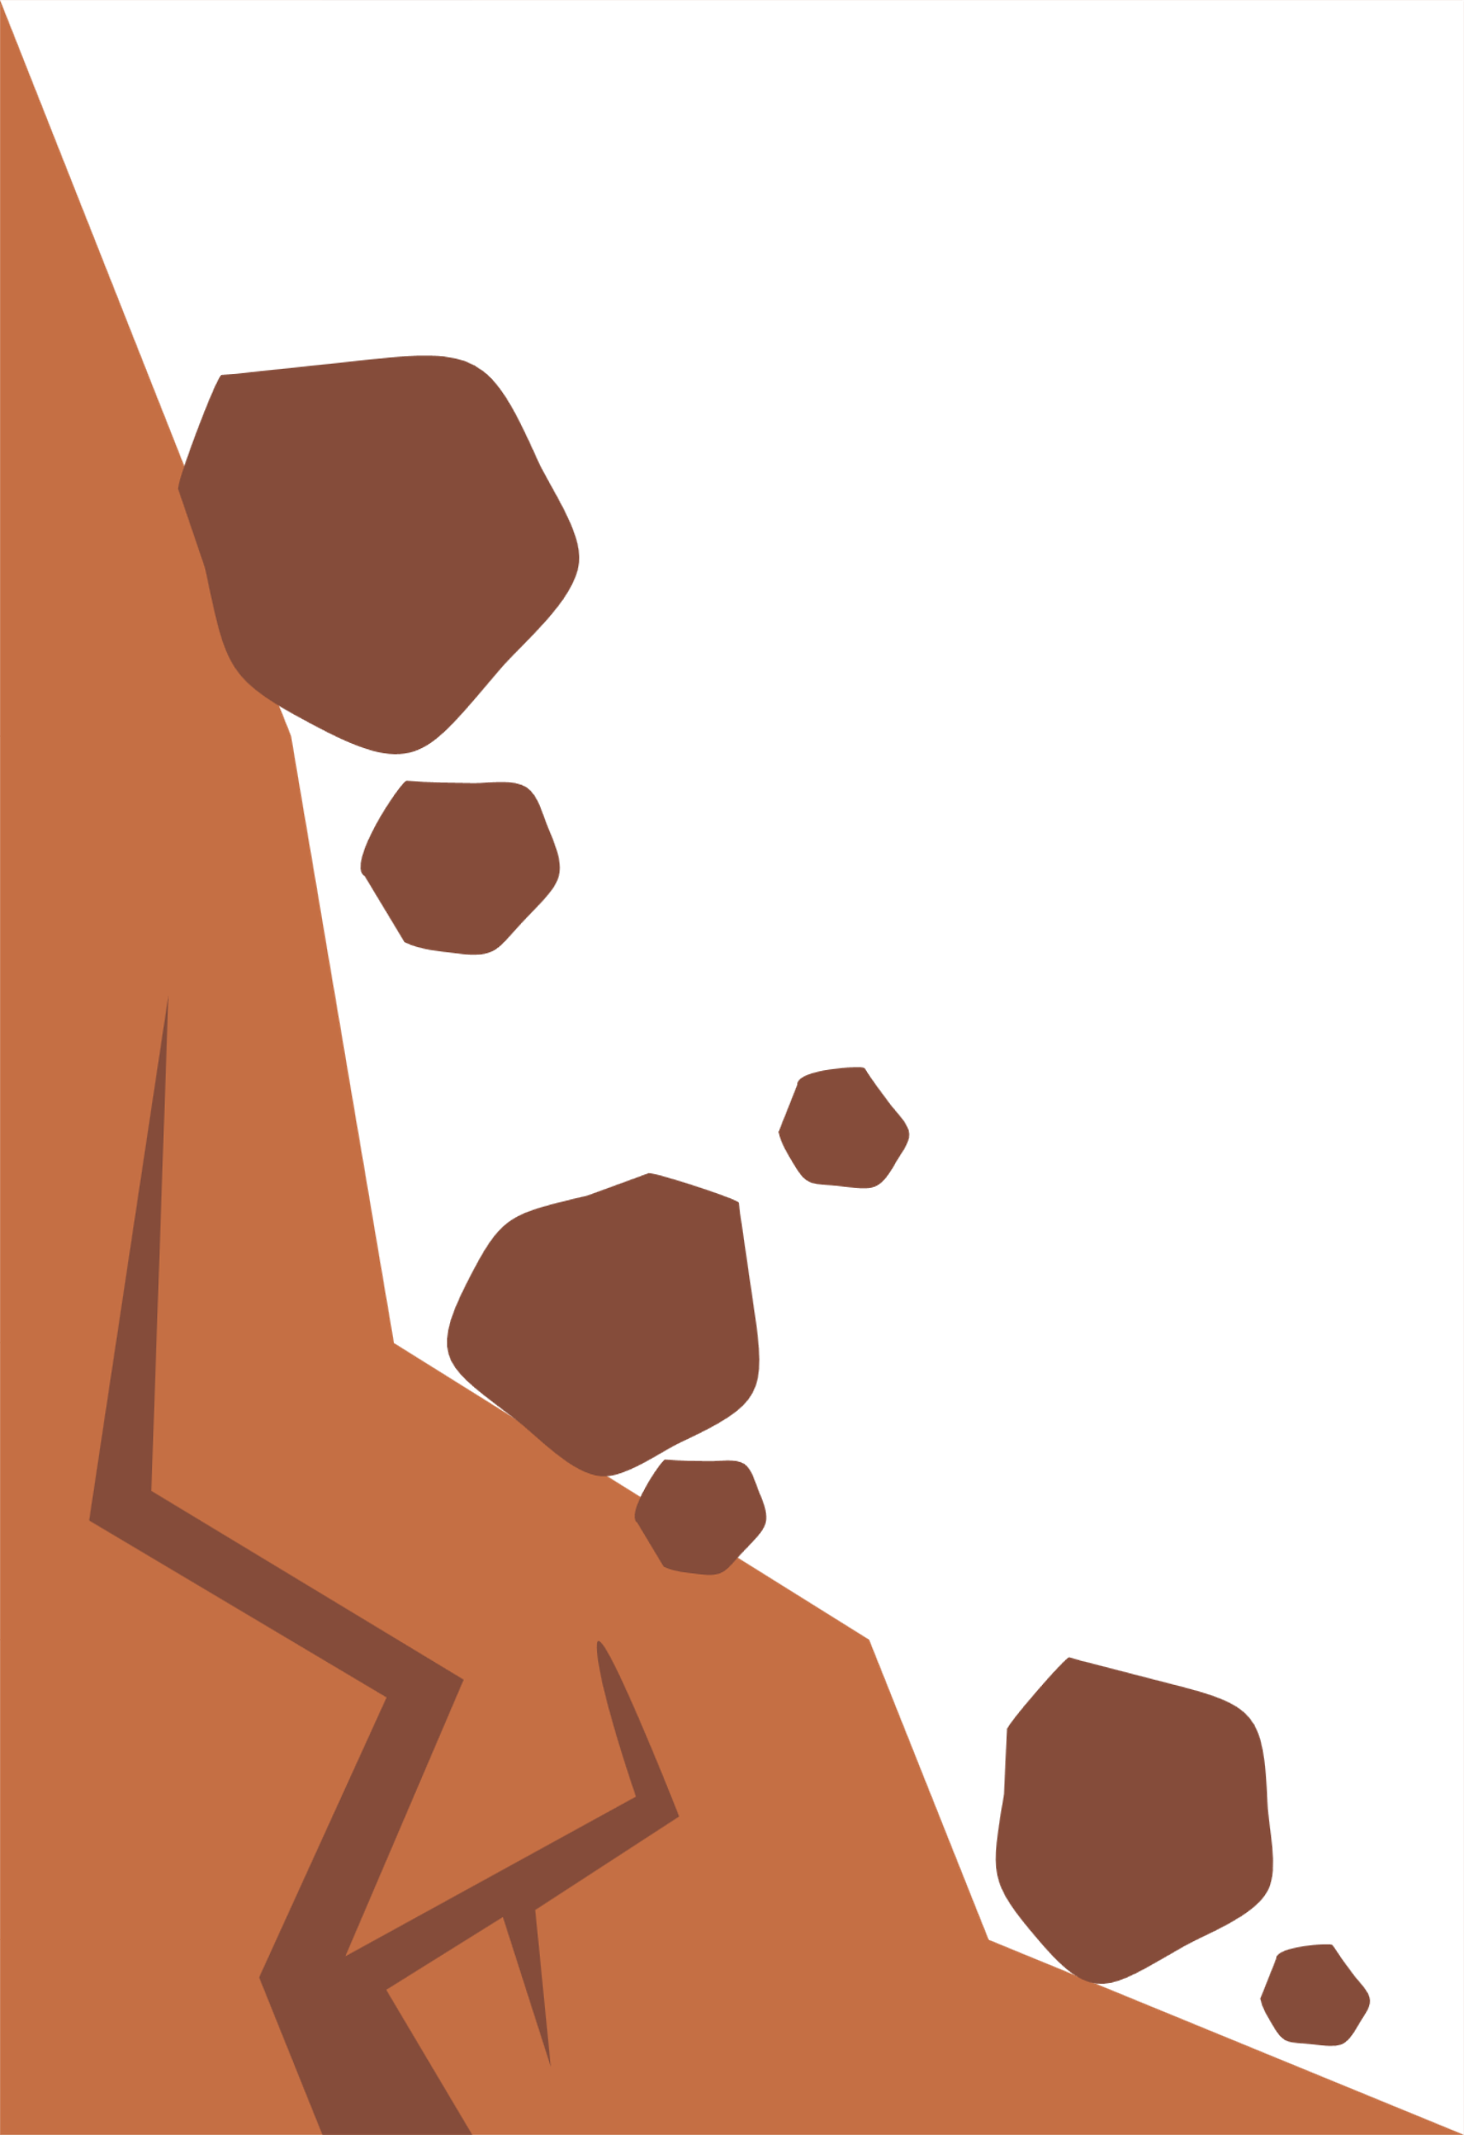
OVERVIEW OF EARTH'S SURFACE PROCESSES
  Weathering: The breakdown of rocks in place (materials stay where they are).
  Erosion: The movement of broken rocks and soil from one place to another.
  Deposition: The dropping or settling of eroded materials in a new location to build landforms.

Slide 3
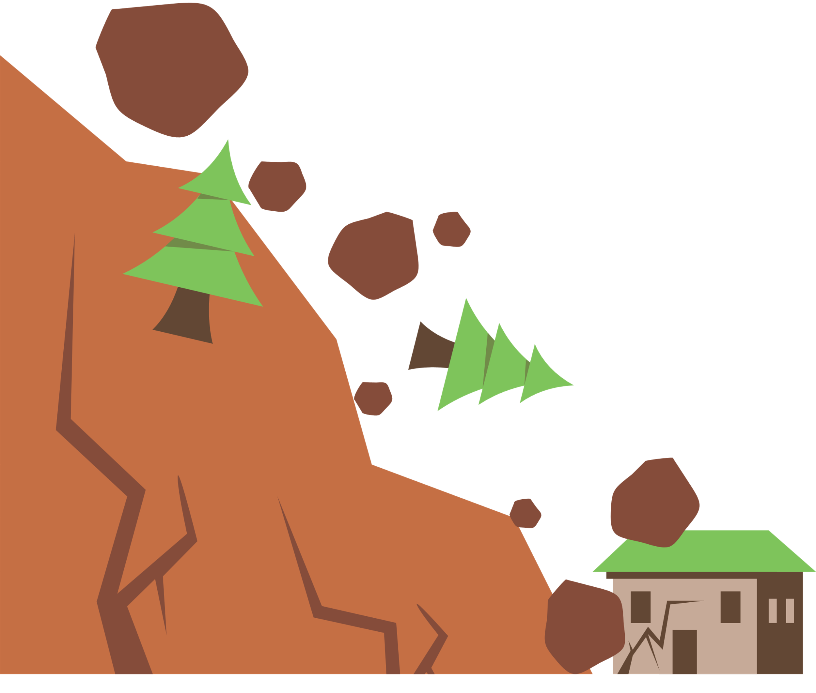
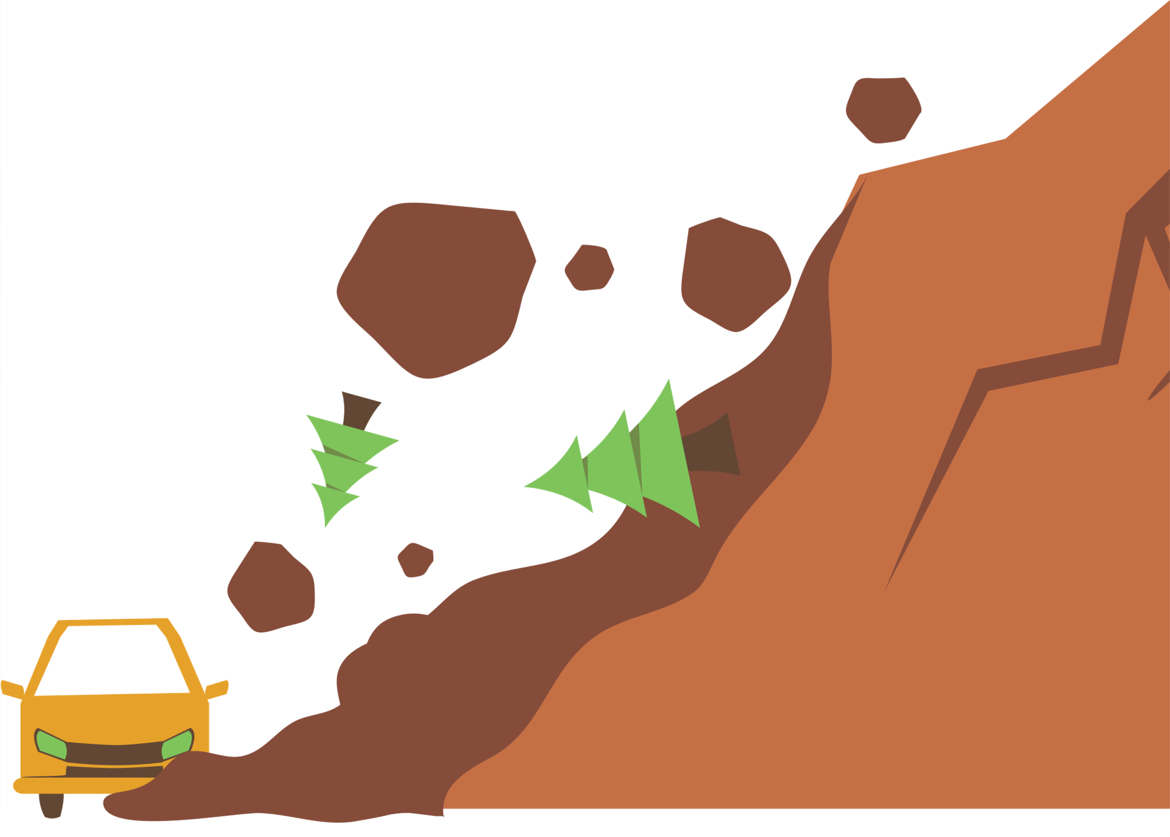
TYPES OF WEATHERING
Mechanical
Chemical
Rock breaks into smaller pieces, but its chemical composition stays the same.
Example: water freezes in a crack and expands.
Living things break or weaken rock.
Example: plant roots grow into cracks; lichens release acids.

Slide 4
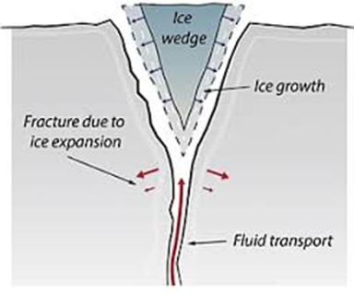
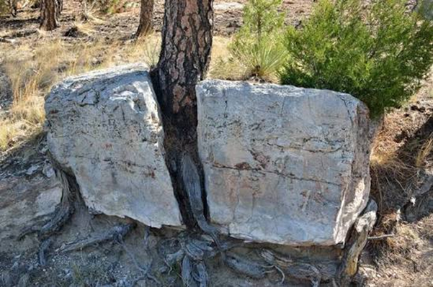
Mechanical Weathering Processes
  Frost Wedging (Ice wedging)
Water enters cracks in rocks, freezes, expands, and gradually widens the cracks until pieces break off.
  Root wedging
Water enters cracks in rocks, freezes, expands, and gradually widens the cracks until pieces break off.

Slide 5
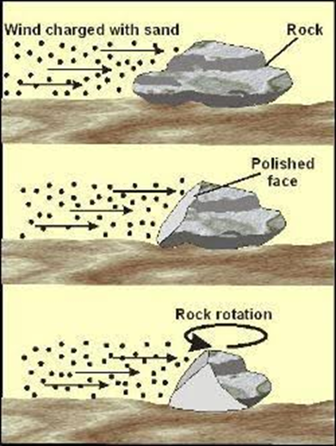
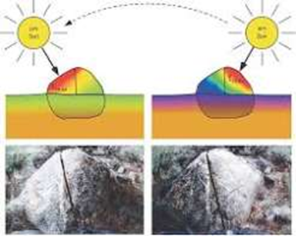
Mechanical Weathering
  Abrassion
Wind, rivers, glaciers, and waves scrape and round rock surfaces through continuous collisions.
  Thermal Expansion
Daily temperature cycles cause outer layers to expand and crack.

Slide 6
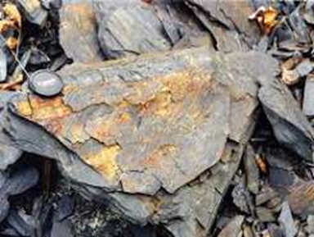
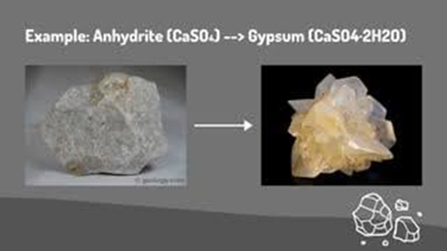
Chemical Weathering
  Oxidation
Interaction with oxygen and moisture that weakens minerals (like rusting).
  Hydration
Minerals absorb water directly into their crystal structure, causing swelling and weakening.

Slide 7
WHEN ROCKS ARE BROKEN DOWN OR WEAKENED BY WEATHERING, WHAT DO YOU THINK HAPPENS TO THE LOOSENED ROCK FRAGMENTS AND SOIL WHEN A FORCE IS APPLIED TO THEM?

Slide 8
WHAT IS EROSION?
DEFINITION:The transport of weathered rock fragments and soil by agents like water, wind, ice, and gravity.
KEY MECHANISMS:The transport of weathered rock fragments and soil by agents like water, wind, ice, and gravity.

Slide 9
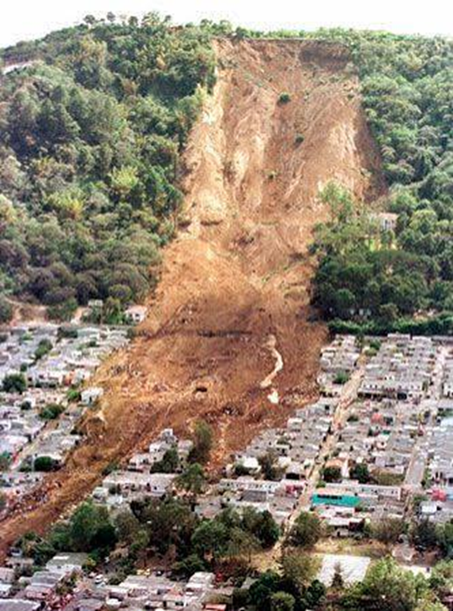
EXAMPLE OF EROSION ?

Slide 10
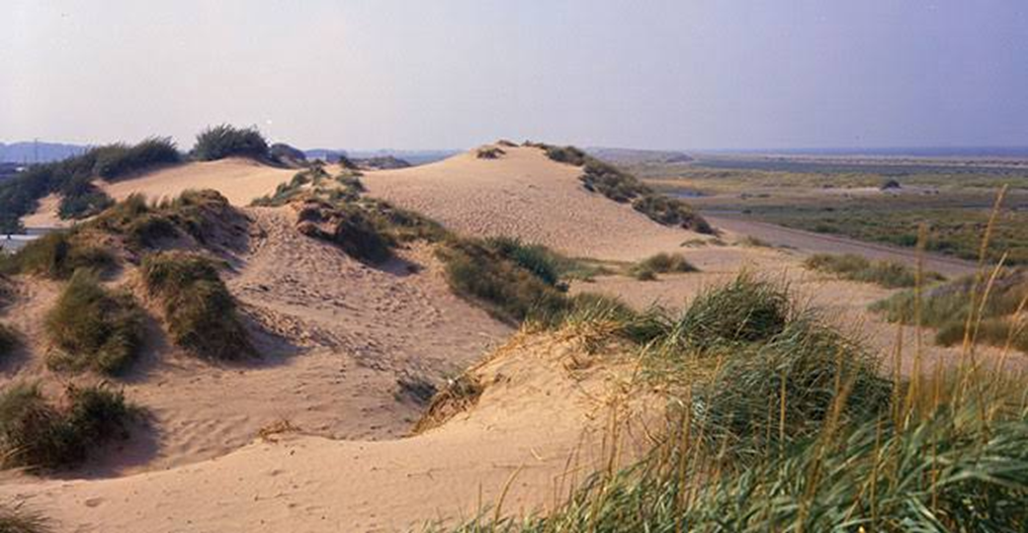
WHAT IS DEPOSITION?
The process where moving agents (water, wind, ice) slow down and drop their sediment load.
Results: Creates new landforms such as river deltas, sand dunes, beaches, and alluvial fans.

Slide 11
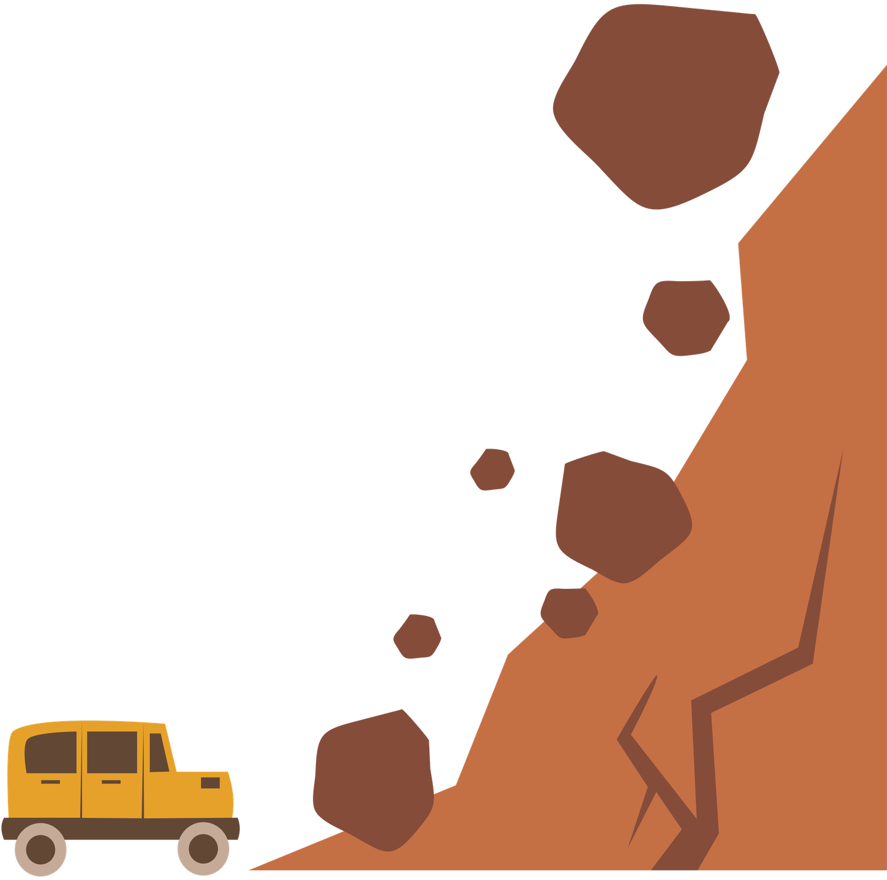

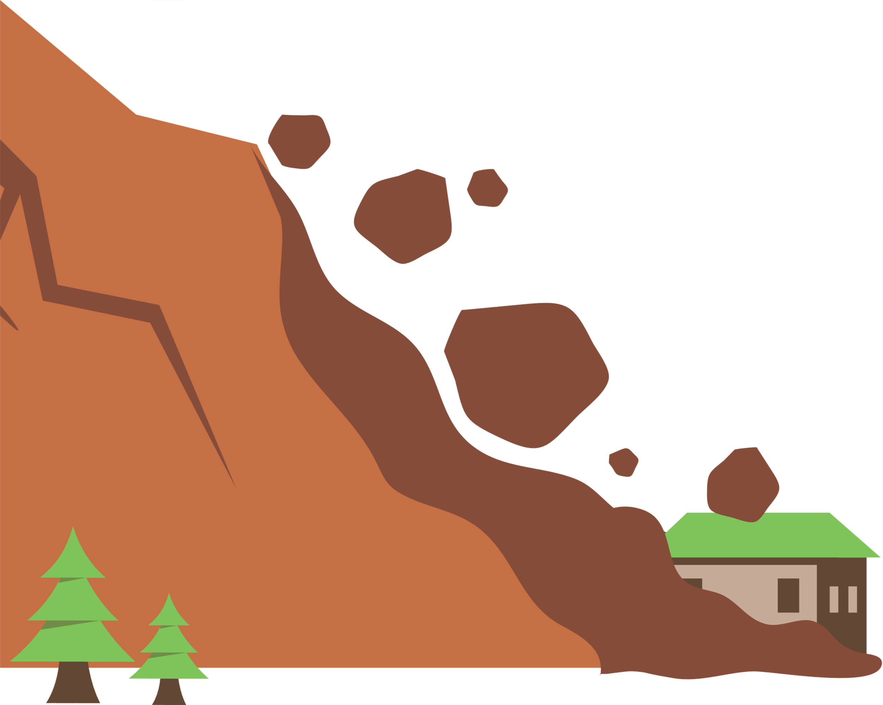
EXIT TICKET
Considering that weathering destroys steel and concrete buildings, erosion erodes soil and often covers infrastructule while deposition disperses water in an area. Are these geological processis still benefician to us humans? Defend your answer using examples.

